Slide 1
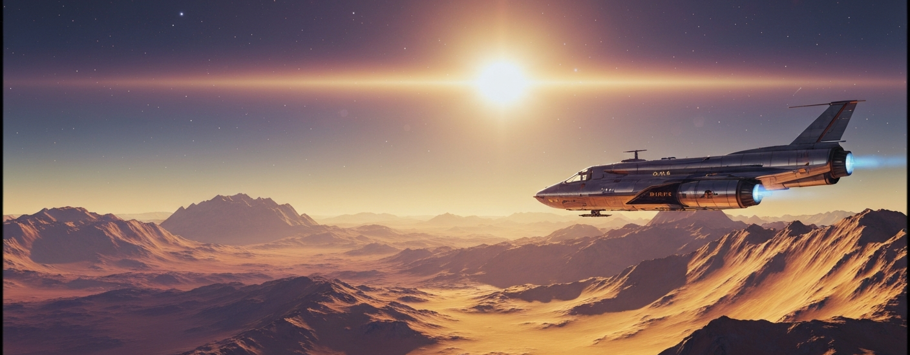
Apollo to Artemis: The Space Narrative
This presentation explores the journey from the first lunar footsteps of Apollo to the sustainable return of Artemis, and how the legacy of past achievements powers the path to Mars.

Slide 2
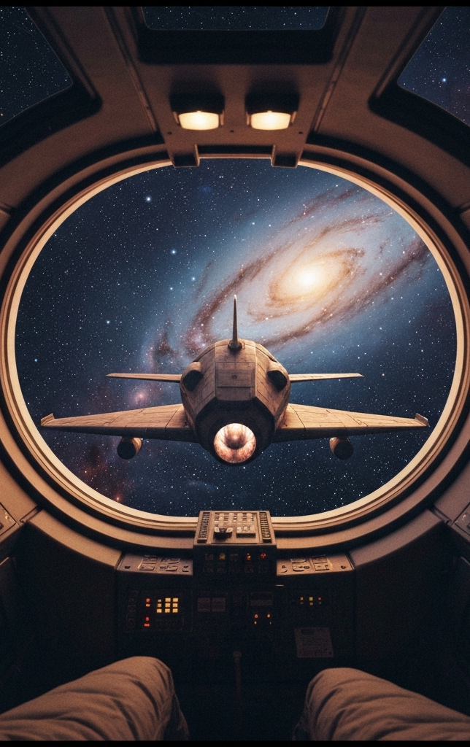
Apollo to Artemis: The Space Narrative
This slide sets the stage for the Apollo to Artemis narrative, exploring how the pioneering achievements of the Apollo era laid the foundation for the ambitious Artemis program and the future journey to Mars. The cinematic hero image captures the grand scale and technical prowess of space exploration, inviting the audience to embark on this narrative journey.

Slide 3
Agenda
Key Figures & Quotes
Highlighting the influential figures and inspiring quotes that shaped the Apollo and Artemis programs.
Vehicle Evolution (Saturn V → SLS/Orion; Starship context)
Comparing the key capabilities and characteristics of the main launch vehicles used in the Apollo and Artemis eras.
Mission Timeline (Apollo to Artemis)
Tracing the major milestones from the Apollo program to the current Artemis development and planned missions.
Budget Trends (inflation-adjusted)
Examining the historical and projected NASA budgets, highlighting the changing scale and focus from Apollo to Artemis.
Technology Advances (materials, computing, guidance)
Showcasing the key technological breakthroughs that have enabled the progress from Apollo to Artemis.
Risks & Mitigations
Identifying the major risks and the corresponding mitigation strategies for the Artemis program.
International Partners
Highlighting the global collaboration and contributions to the Artemis program.
Cultural Impact
Exploring the lasting influence of the Apollo and Artemis programs on science, technology, and society.
What's Next
Outlining the near-term, mid-term, and longer-term goals and milestones for the Artemis program and the journey to Mars.

Slide 4

gene_cernan
Apollo 17 commander; last human to walk on the Moon (1972). Geology-focused exploration with Harrison Schmitt.

Slide 5
Vehicle Evolution: Saturn V → SLS/Orion (with Starship Context)
Comparison of payload delivery to Low Earth Orbit (LEO) and Trans-Lunar Injection (TLI) for major launch vehicles
140
150
105
95
Saturn V
SLS Block 1
SLS Block 1B
Starship (HLS variant)

Slide 6
Mission Timeline: Apollo to Artemis
1961
1969
2022
2026
JFK sets Moon goal (within the decade)
Apollo 11: first lunar landing
Artemis I: uncrewed SLS/Orion lunar mission
Artemis III: crewed lunar landing (NET)
1968
1972
2025
2028
Apollo 8: first crewed lunar orbit; Earthrise
Apollo 17: last crewed Moon landing of Apollo era
Artemis II: crewed lunar flyby (NET)
Artemis IV: Gateway assembly; SLS Block 1B (NET)

Slide 7







Budget Trends (Inflation-Adjusted)
Apollo Peak (1966)
Artemis Era (2020)
Artemis Projected (2024)
NASA Constant-$ Peak

Slide 8
Technology Advances: Materials, Computing, Guidance
Materials
Computing
From aluminum alloys to Al-Li, composites, and additive-manufactured engine parts. Thermal protection: ablative heat shields → refined TPS materials and arc-jet validated repairs.
Apollo Guidance Computer: tens of kilobytes of memory; deterministic real-time design. Modern rad-hard processors: orders-of-magnitude more compute; fault tolerance; model-based FSW.
Guidance, Navigation & Control
Systems Integration
Inertial platforms → strapdown IMUs + star trackers + GNSS assist near Earth. Terrain Relative Navigation (TRN), hazard detection LIDAR, precision powered descent for landers.
Digital twins and HIL testbeds for avionics and propulsion. Closed-loop ECLSS improvements; deep-space comms including optical/laser links.

Slide 9






Risks and Mitigations
Heat shield/charring behavior in high-energy reentry
Deep-space radiation exposure (SPEs, GCRs)
Lunar landing precision and hazard avoidance
On-orbit cryogenic propellant transfer for HLS
Integration/schedule complexity across providers
Budget volatility and policy shifts
Design refinements, arc-jet/flight-like test coupons, instrumented reentry data closeout before crewed flight.
Storm shelters, passive materials, mission timing, dosimetry and operational constraints.
Terrain Relative Navigation, autonomous hazard detection, rehearsals with uncrewed demos and simulations.
Incremental demos, boil-off control, multi-tanker architecture with ground test correlation.
Interface control, phased verification, margin reserves, independent readiness reviews.
Modular milestones, international cost-sharing, multi-year procurement strategies.

Slide 10



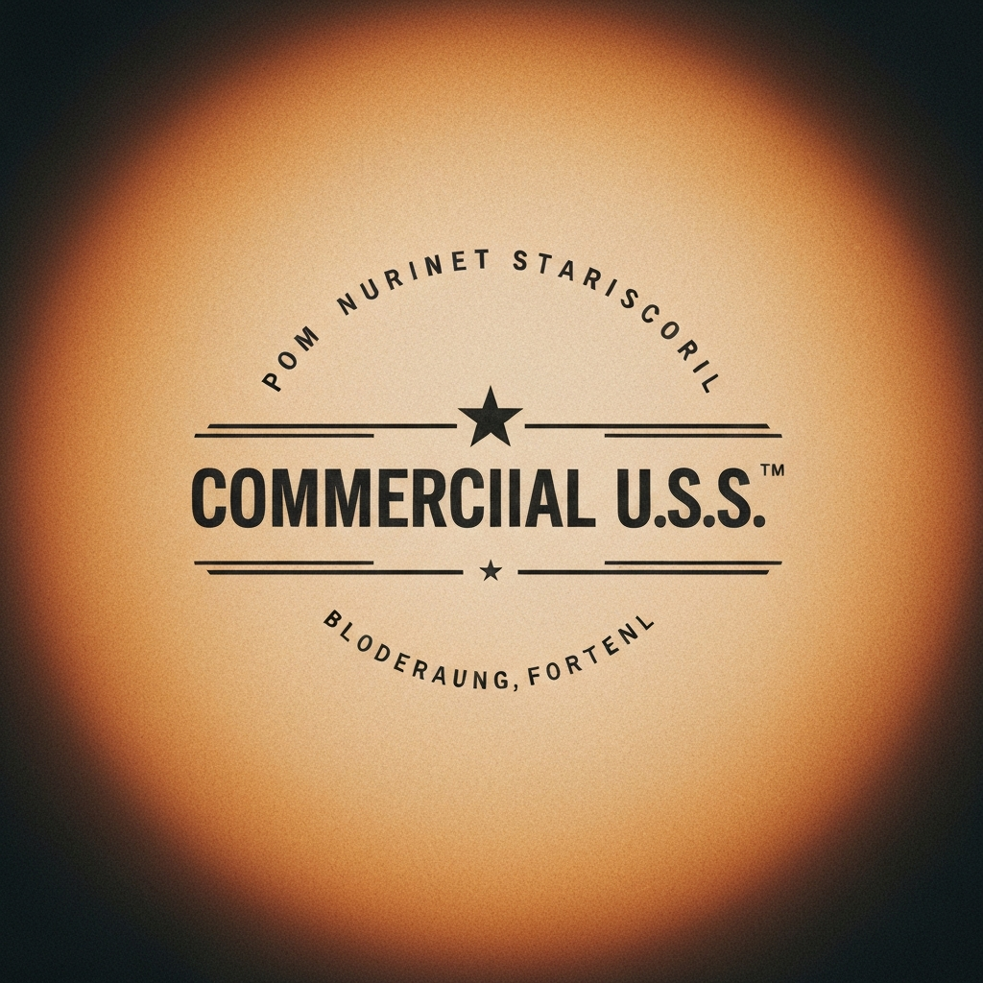
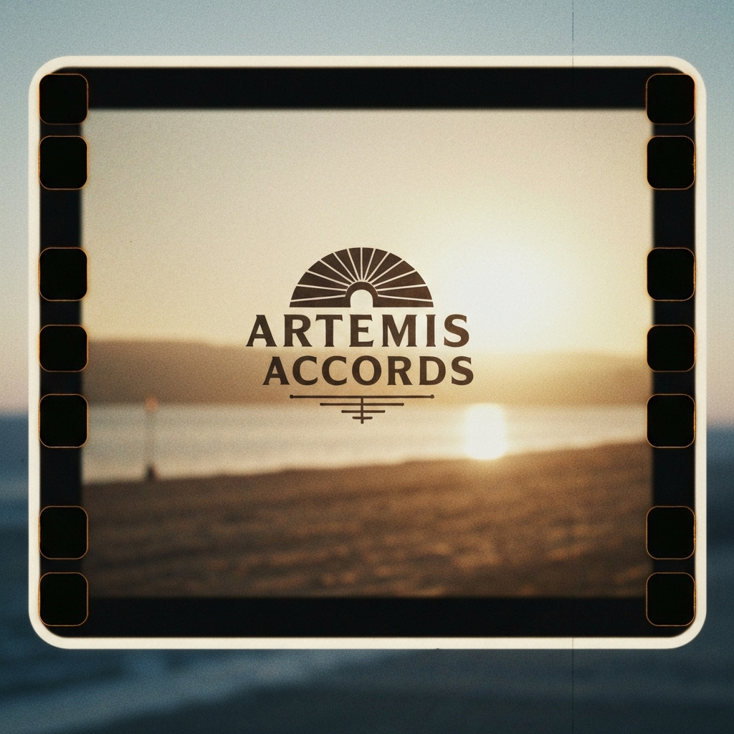
International Partners

Slide 11
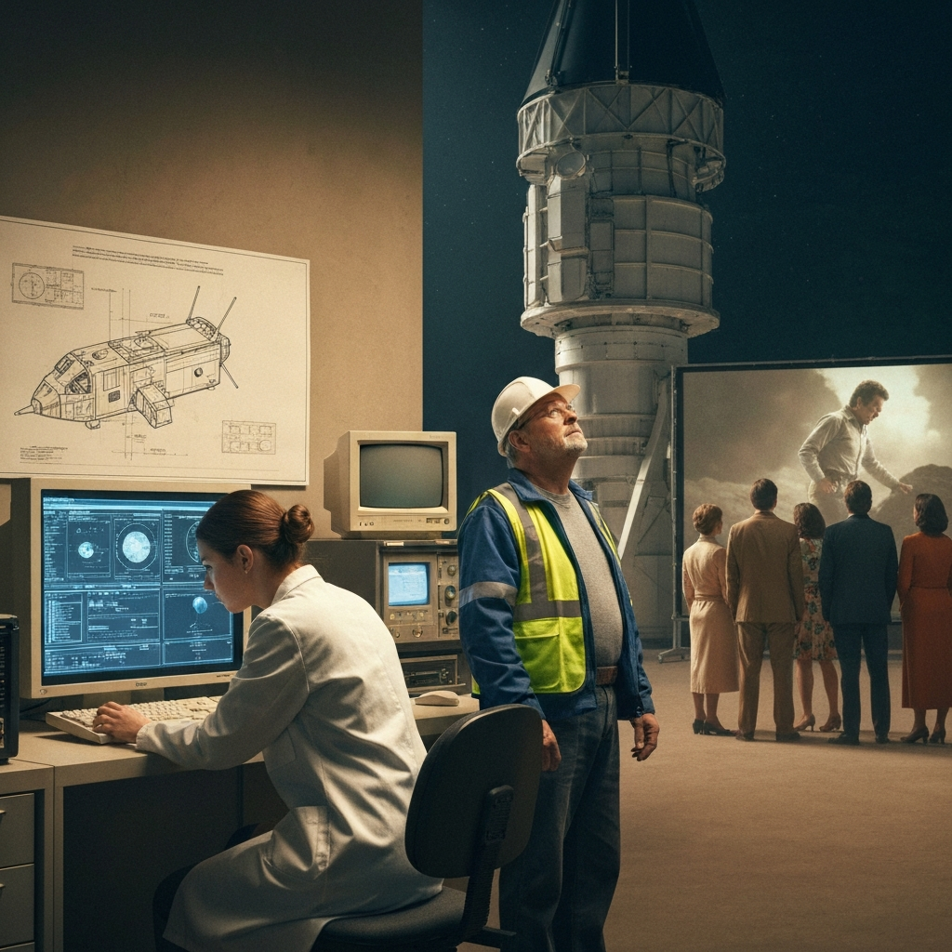
Cultural Impact
The Apollo and Artemis programs have had a profound and lasting impact on science, technology, and society. The iconic images captured during these missions, such as the Earthrise photograph from Apollo 8 and the Blue Marble shot from Apollo 17, have reshaped global environmental awareness and inspired generations of scientists, engineers, and explorers.

Slide 12





What's Next
Near-term (0-3 years)
Mid-term (3-7 years)
Longer-term (7+ years)

Slide 13

The transition from Apollo to Artemis marks a new era of space exploration, built upon the pioneering achievements and technological advancements of the past. As we embark on the Artemis program, we stand poised to make further strides in lunar exploration, establish a sustainable human presence on the Moon, and pave the way for the ultimate goal of reaching Mars. The future of space exploration is bright, and the lessons learned from Apollo continue to guide and inspire us as we push the boundaries of what is possible.

